Slide 1
NeuroClone
Team Inception
ITSP 2020
Om Mihani
Akshata Koshti
Siddhi Gaikwad
Adit Agrawal
Vaishnavi Agnihotri

Slide 2
Idea behind the project
We control our body parts via signals generated by the brain. The signals are generated and transmitted to the body via nerves. In few cases however, this connection is weakened or broken, causing paralysis. But, the brain may still be generating signals. We aim to help such people by giving these signals to a robot and operating it merely by thoughts. It also can be used(with modifications) in places where a human can’t go.
We present here the first stage of such a project.

Slide 3
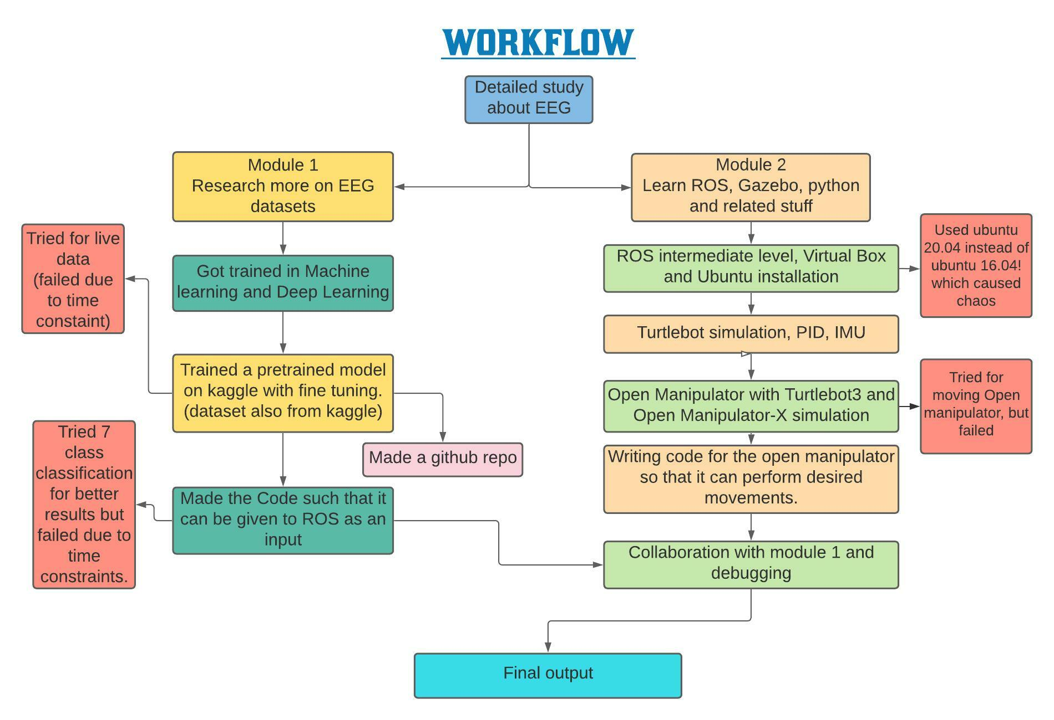

Slide 4
Project Details
Deep study about brain Computer interfacing and EEG
Searching for data set and Learning softwares
Simultaneous Model training and ROS work by 2 parts of the team.
Testing of code, Trying on live data, Collaboration
Current status of robot

Slide 5
Dataset details
Source : Kaggle
Description : This data contains EEG recordings of subjects performing grasp-and-lift (GAL) trials. It contains a raw dataset and corresponding results.
Training details:
Model used : CNN
Framework used : Pytorch
ROS Detailing
UBUNTU 16.04 on VirtualBox
ROS version : Kinetic Kame
Turtlebot and Open Manipulator Details
Version used for SLAM and navigation : Turtlebot3 Waffle
Open Manipulator used : Open manipulator-X and Open manipulator with TB3
ROS Code for hand robot motion
Used om_service_call_examples from github
Om_moveit_examples for motion

Slide 6
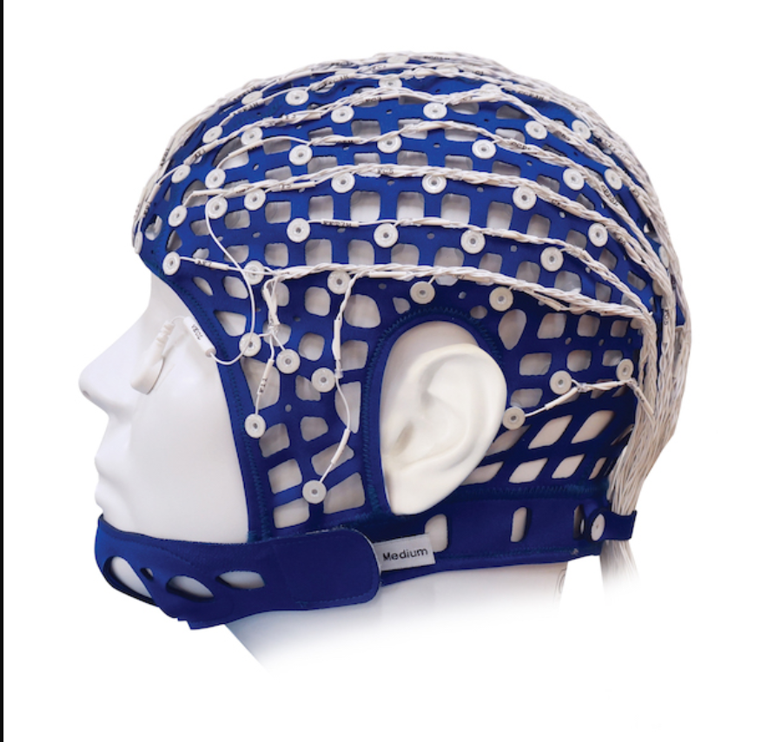

Results (Images/Videos)

Slide 7
Skills learnt
Python, MATLAB
Basics of machine learning
Deep learning
Configuring Ubuntu environment
ROS and Turtlebot
Open Manipulator Simulation
Combining the deep learning model and working of hand robot
Team work
Time management & Planning
Researching and contacting with seniors/experts

Slide 8
Challenges faced
Collecting relevant datasets of EEG
Selecting the BCI (EEG/MEG)
Exact mapping to the electrode to site
Training the neural network model on large size of data (frequent RAM crashes)
Tried developing a model which can work on Live data but due to time constraint we were unable to perform the experiment
Tried for moving open manipulator but failed
Used Ubuntu 20.4 instead Ubuntu 16.04
Frequency for Turtle bot and PyTorch were different.

Slide 9
Challenges faced
There may be a device with lesser channels during presentation.(challenge for live data)
We didn’t get the accuracy we were expecting for the output. Hence we tried to do 7 class classification instead of 6 and softmax instead of Sigmoid but didn’t get much difference.

Slide 10
Conclusion/Future plans
We have made the robot to such a stage where it can be easily modified to do any specific task depending on the dataset.
Our future plan is to do the following:
Make the robot ready for taking live signals. (That’s where it will be practically usable)
Give audio visual feedback from the environment of the robot to the controller, thus giving a real life experience
Introduce legs instead of wheels, and make the robot boy closer to that of a human
Train with many more datasets so as to prepare the robot to do any practical task.
Make the robot physically (This will be a Eureka achievement)
Put the robot in the market and commercialize the product

